Slide 1


The Pitbull Store
Woof woof pet time …
Team Members:
20CS023 JAYRAJ KARELIA
20CS027 SHUBHANG KHEMANI
20CS030 KALPESH MAHIDA
SGP-II
Guided By : Mayuri Popat Bhupendra Patel

Slide 2
CONTENTS OF THIS PRESENTATION
Problem Statement
Project Scope and Objectives
Comparative study with similar projects
Salient Features
Flowchart/System Flow
GUI and database design
Timeline
References

Slide 3
1.Problem Statement
This website makes life of a pet owner much easier , they can find one stop solution by providing the most relatable products suitable for a pet according to the pets comfort and owners requirement.They won’t have to carry their pets and waste their time by visiting the store every now and then . Also we decided to provide services such as pet therapy and wellness, to improve the pets condition.

Slide 4
PROBLEMS AND SOLUTIONS
PROBLEM
To visit pet store too often to find various pet amenities and figuring out therapy for pet wellness and searching for products to keep them healthy.
SOLUTION
Our website.

Slide 5
2. Project Scope and Objectives
The basic motto of this project is to give customers a one stop platform for all the pet amenities they will need to give their pets the best life..
Our website provides all the necessary details needed to keep your pets in the pink of their health, and find the best suitable products from the comfort of the owners home.
We also have entertainers, small toys to keep your pet busy in their play.
Users can also book a pet school appointment schedule to have a mannered pet you dream of…
A pet day care appointment to keep your pet busy while you have your work done….

Slide 6




03.Comparative study with similar projects
We came across many similar websites as a reference and thought of including various feature , some of them being unique , and combined them all at once to show the contents and features in our website.The features such as availability of pet care amenities , providing pet therapy , products used by pet and pet owners in day to day life as well as description of various pets will be found on our website.

Slide 7
4.Salient Features
01
02
03
04
User-Login System
Chatbot Assistance
Multilingual
Responsive
Manymore….
User can create a personal account on our website
We have included a chatbot that will help you solve your problems in no time
We are also providing multiple language options on the website.
Responsive design serves all devices with the same code that adjusts for screen size.

Slide 8
Flowchart/System Flow
login
No
Sign-Up
Homepage
Food
Toys
Leash and harness
Grooming
Subscriptions
Bedding
PAYMENT

Slide 9
Graphical User Interface

Slide 10
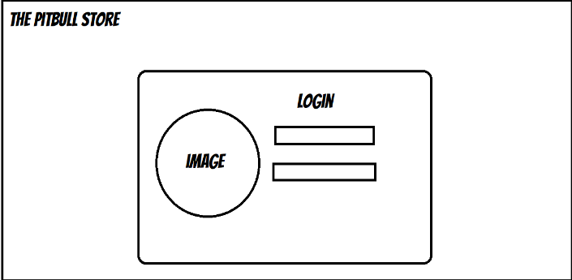
User Login

Slide 11
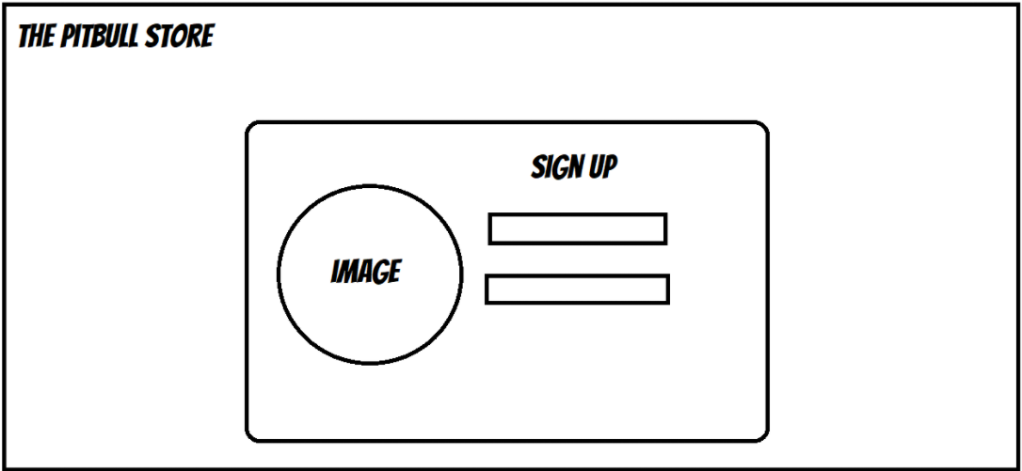
Sign Up

Slide 12
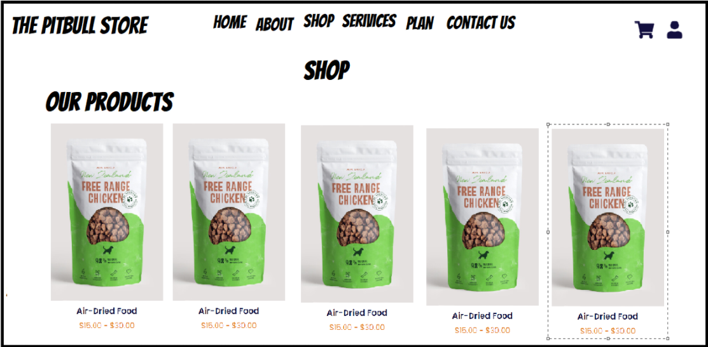
Store

Slide 13
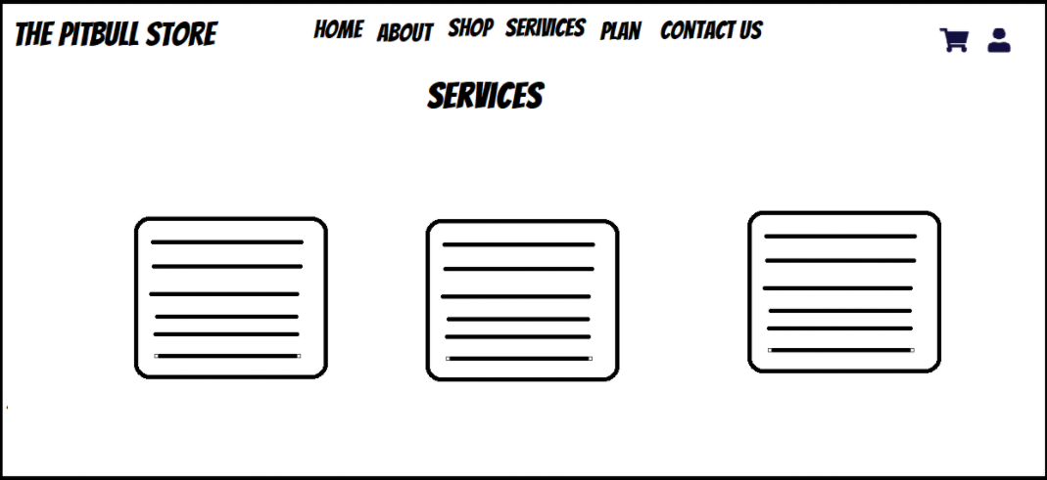
Services

Slide 14
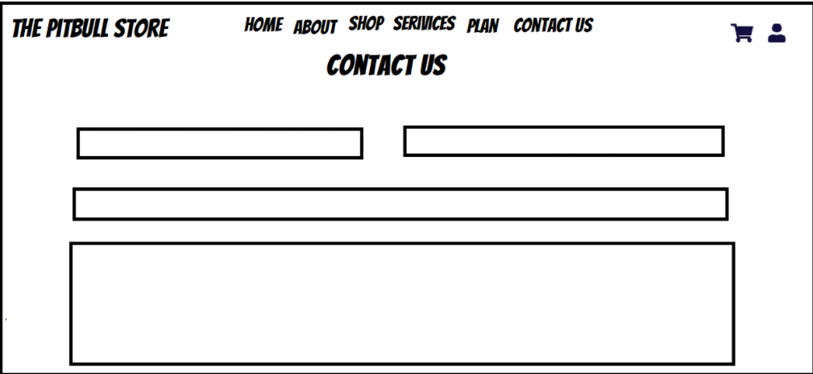
Contact Us

Slide 15
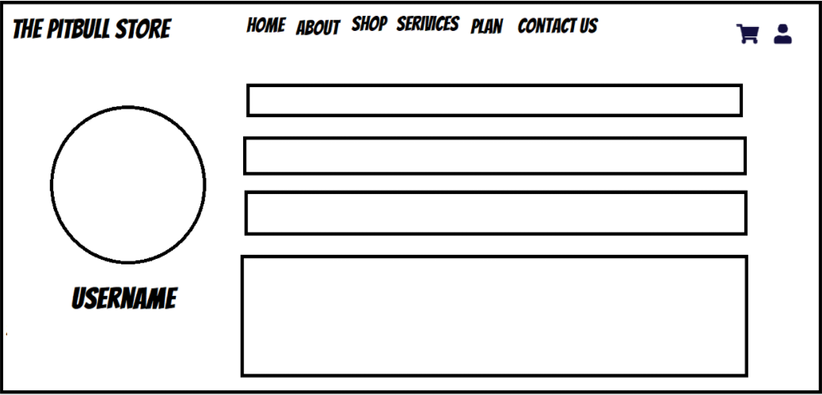
User Profile Page

Slide 16
References
https://www.oliverpetcare.com/
https://petstore.com/
https://www.thepetstore.co.in/
https://dearpet.in/

Slide 17
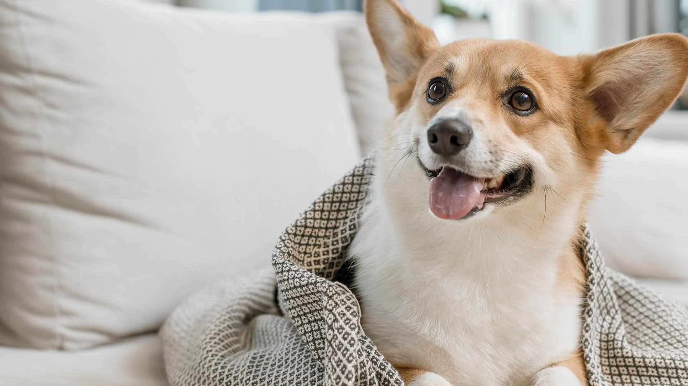
A PICTURE IS WORTH A THOUSAND WORDS

Slide 18
THANK YOU!!
THE PITBULL STORE
Team Members:
20CS023 JAYRAJ KARELIA
20CS027 SHUBHANG KHEMANI
20CS030 KALPESH MAHIDA

